Slide 1

Time Series Challenge (Summer 2024)
Heat and water Demand forecasting
Presented by : Jagruti Godambe
Supervisors:
Dr.-Ing. Tomás Arias-Vergara
M.Sc. Adithya Ramachandran

Slide 2
Agenda
Time Series Challenge
01
Motivation
02
Introduction
03
Dataset Overview
04
Data Preprocessing
05
Architecture
06
Model Evaluation
06
Conclusion

Slide 3



Motivation
Time Series Challenge
Notes:
As our world faces rapid population growth, urbanization, and climate change, it's becoming more important than ever to predict heat and water demand accurately.
In cities, these predictions help us manage resources better, save energy, and cut costs, making our cities more sustainable and ready for the future.
In agriculture, knowing how much water is needed helps farmers use it wisely, grow more food, and tackle water shortages.
In industries, accurate forecasts improve production planning, inventory management, and resource use, leading to efficiency, savings, and a smaller environmental impact.
Overall, predicting heat and water demand is key to sustainable development and preparing for future challenges.

Slide 4



Introduction
Time Series Challenge
Downstream Task:
Historical Heat and Water data
Forecasting model
Prediction for next 24 hours

Slide 5



Dataset Overview
Time Series Challenge
Heat Demand Data for urban population
Training data
Hourly heat demand data (kWh)
Heat Demand
Data
Testing data
Consumption data with 24 ahead missing forecasting values
Contributed meters
Number of household meters at particular timestamp

Slide 6
Dataset Overview
Time Series Challenge
Water Demand Data for urban and rural population
Training data
Hourly water demand data
Water Demand
Data
Testing data
Consumption data with 24 ahead missing forecasting values
Contributed meters
Number of household meters at particular timestamp
Notes:
heloo

Slide 7
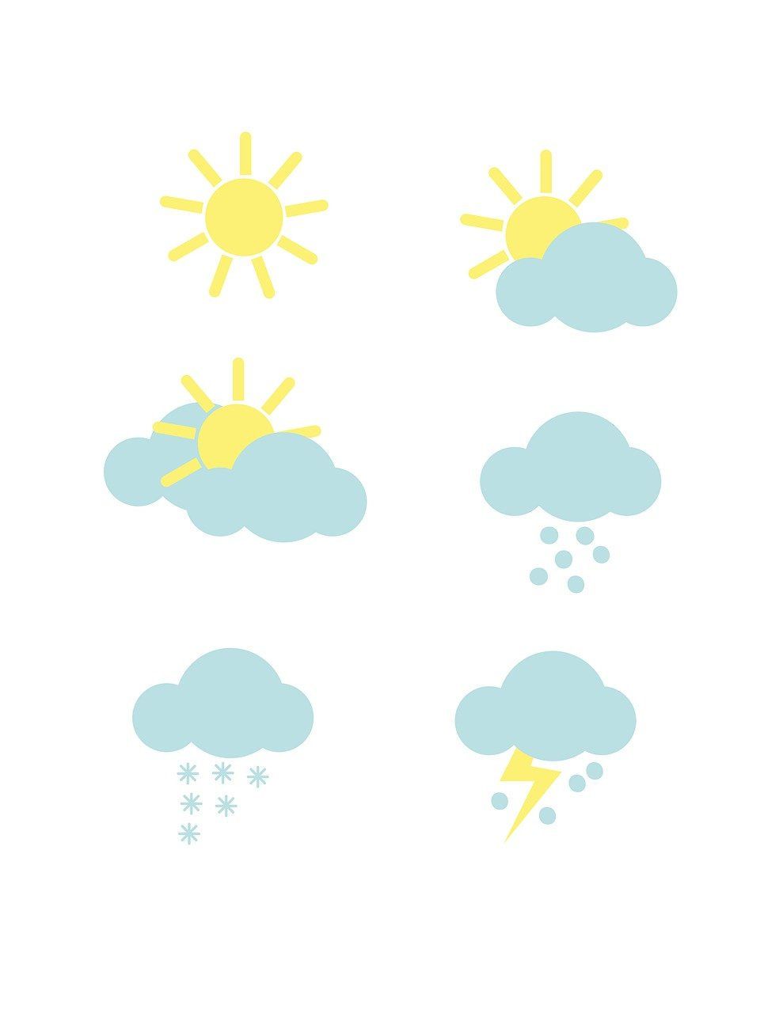
Dataset Overview
Time Series Challenge
Weather Data:
Timestamp, Temperature, Feels like, Weather Description,
Latitude, Longitude….. etc.

Slide 8





Data Pre-Processing
Time Series Challenge
Applied to numerical features to normalize the data
Introduces a new feature Consumption per Meter.
Min-Max Scaling
Feature Engineering
Linear Interpolation
One hot encoding
Feature Selection
Used to estimate and fill missing heat consumption data.
Converts categorical variables into a binary matrix.
Dropping Irrelevant Features.

Slide 9
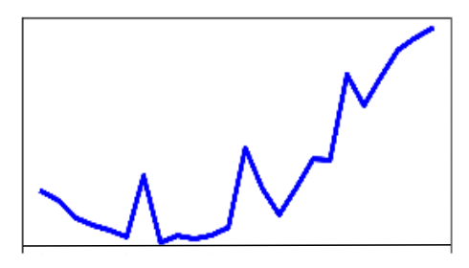
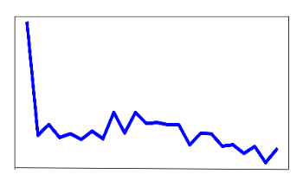
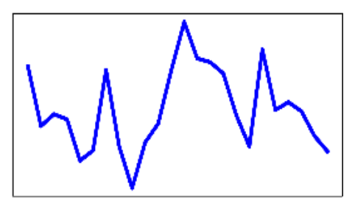
Architecture : Heat Demand Forecasting
Time Series Challenge
Heat consumption
LSTM Neural Network
1 input layer , 2 hidden layers with 256 neurons in each layer, 1 linear and 1 output layer
Contributing meters
Weather data
Forecasted heat consumption for next 24 hours
5 Layer LSTM Neural Network
Input
Optimizer: Adam
Loss: MSE
Batch size: 32
Learning rate: 0.001

Slide 10
Architecture : Water Demand Forecasting (Urban)
Time Series Challenge
Water consumption
LSTM Neural Network
1 input layer , 1 hidden layers with 256, 1 linear and 1 output layer
Contributing meters
Weather data
4 Layer LSTM Neural Network
Forecasted water consumption for next 24 hours
Input
Optimizer: RMS
Loss: MSE
Batch size: 32
Learning rate: 0.0006

Slide 11
Architecture : Water Demand Forecasting (Rural)
Time Series Challenge
Water consumption
LSTM Neural Network
1 input layer , 2 hidden layers with 256 neurons in each layer, 1 linear and 1 output layer
Contributing meters
Weather data
Forecasted water consumption for next 24 hours
5 Layer LSTM Neural Network
Input
Optimizer: Adam
Loss: MSE
Batch size: 32
Learning rate: 0.01

Slide 12
Model Evaluation
Time Series Challenge
Evaluation Metrics:
Mean Absolute Error (MAE) and MAPE were used to evaluate model performance.
Data/Metrics | MAE | MAPE (%)
Heat DMA | 177.739 | 0.0653
Water DMA 1 | 1.604 | 0.137
Water DMA 2 | 0.489 | 0.221
Data/Metrics | MAE | MAPE
Heat DMA | 425.9 | 0.112
Water DMA 1 | 11.529 | 1.151
Water DMA 2 | 0.501 | 0.191
Deep Learning Based Forecasting Model from the lab
Deep Learning Based Forecasting Model obtained by me

Slide 13
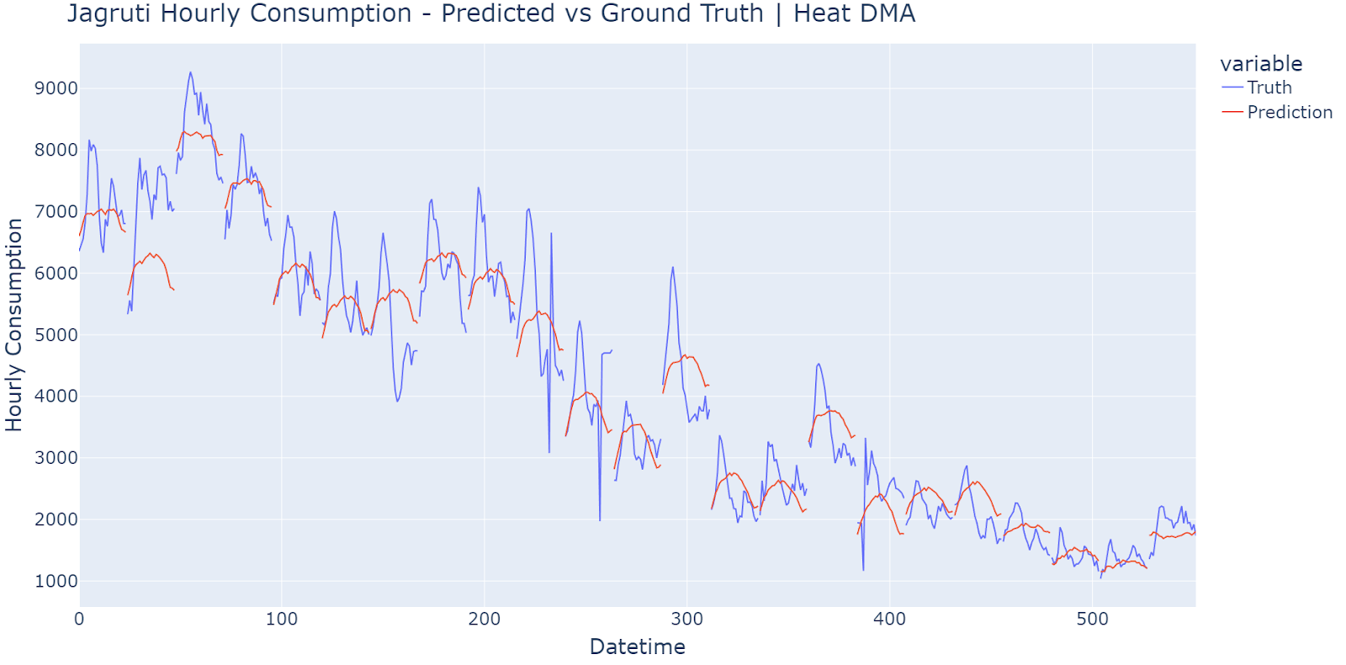
Model Evaluation
Time Series Challenge

Slide 14
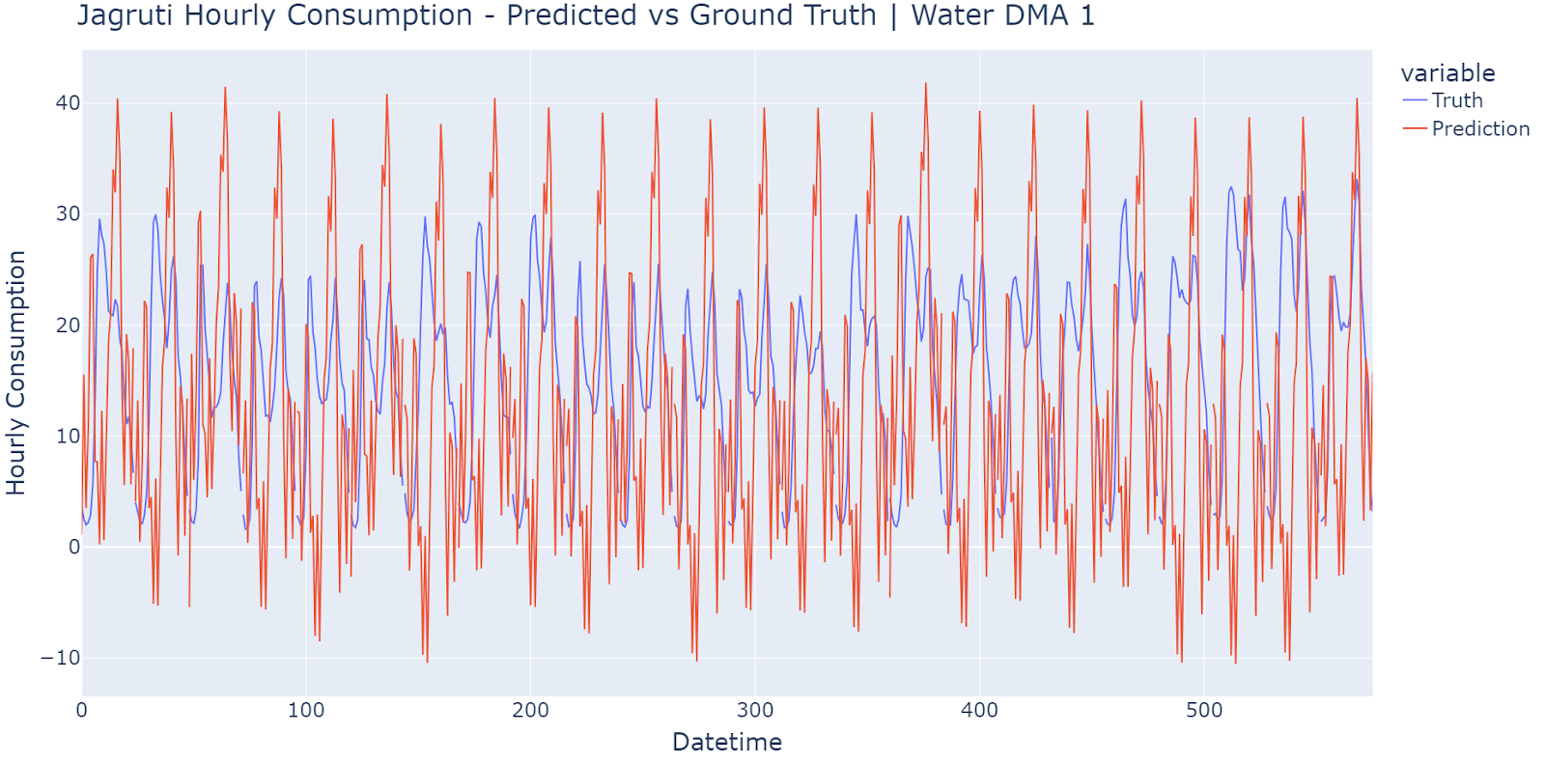
Model Evaluation
Time Series Challenge

Slide 15
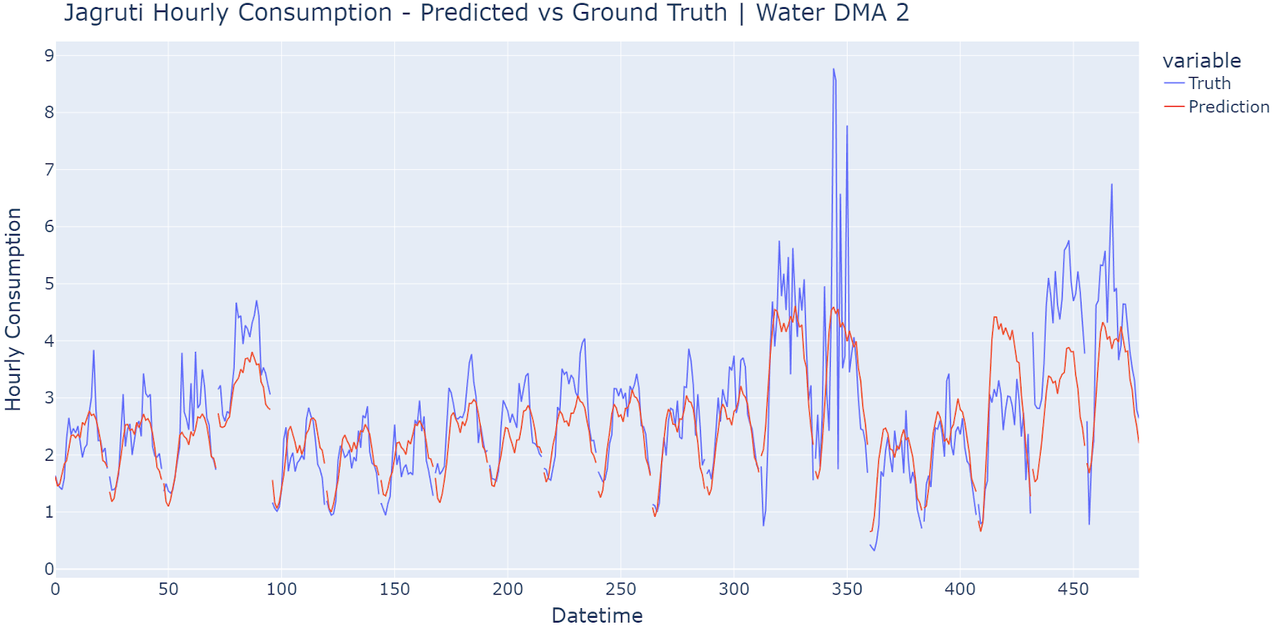
Model Evaluation
Time Series Challenge

Slide 16
Conclusion
Heat and Water Demand Forecasting
LSTM models are highly effective for forecasting heat and water demand due to their ability to capture temporal and non-linear patterns in time series data.
LSTM outperform traditional methods but require more data, computational power, and careful tuning.
Data/Metrics | MAE | MAPE (%)
Heat DMA | 177.739 | 0.0653
Water DMA 1 | 1.604 | 0.137
Water DMA 2 | 0.489 | 0.221

Slide 17
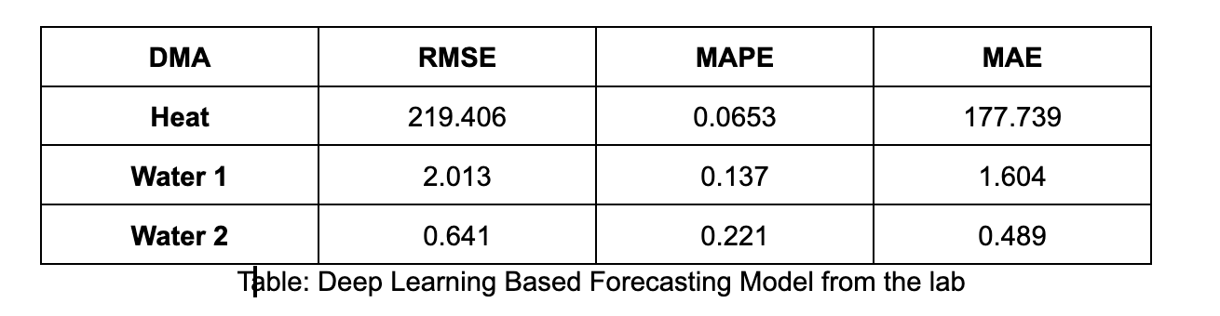
Data/Metrics | MAE | MAPE (%) | RMSE
Heat DMA | 368.01 | 9.43 | 535.12
Water DMA 1 | 11.52 | 115.17 | 14.27
Water DMA 2 | 0.50 | 19.19 | 0.73

Slide 18
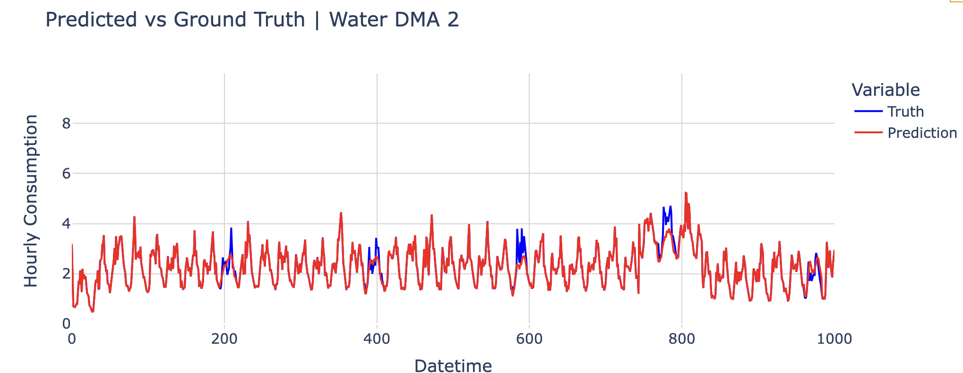
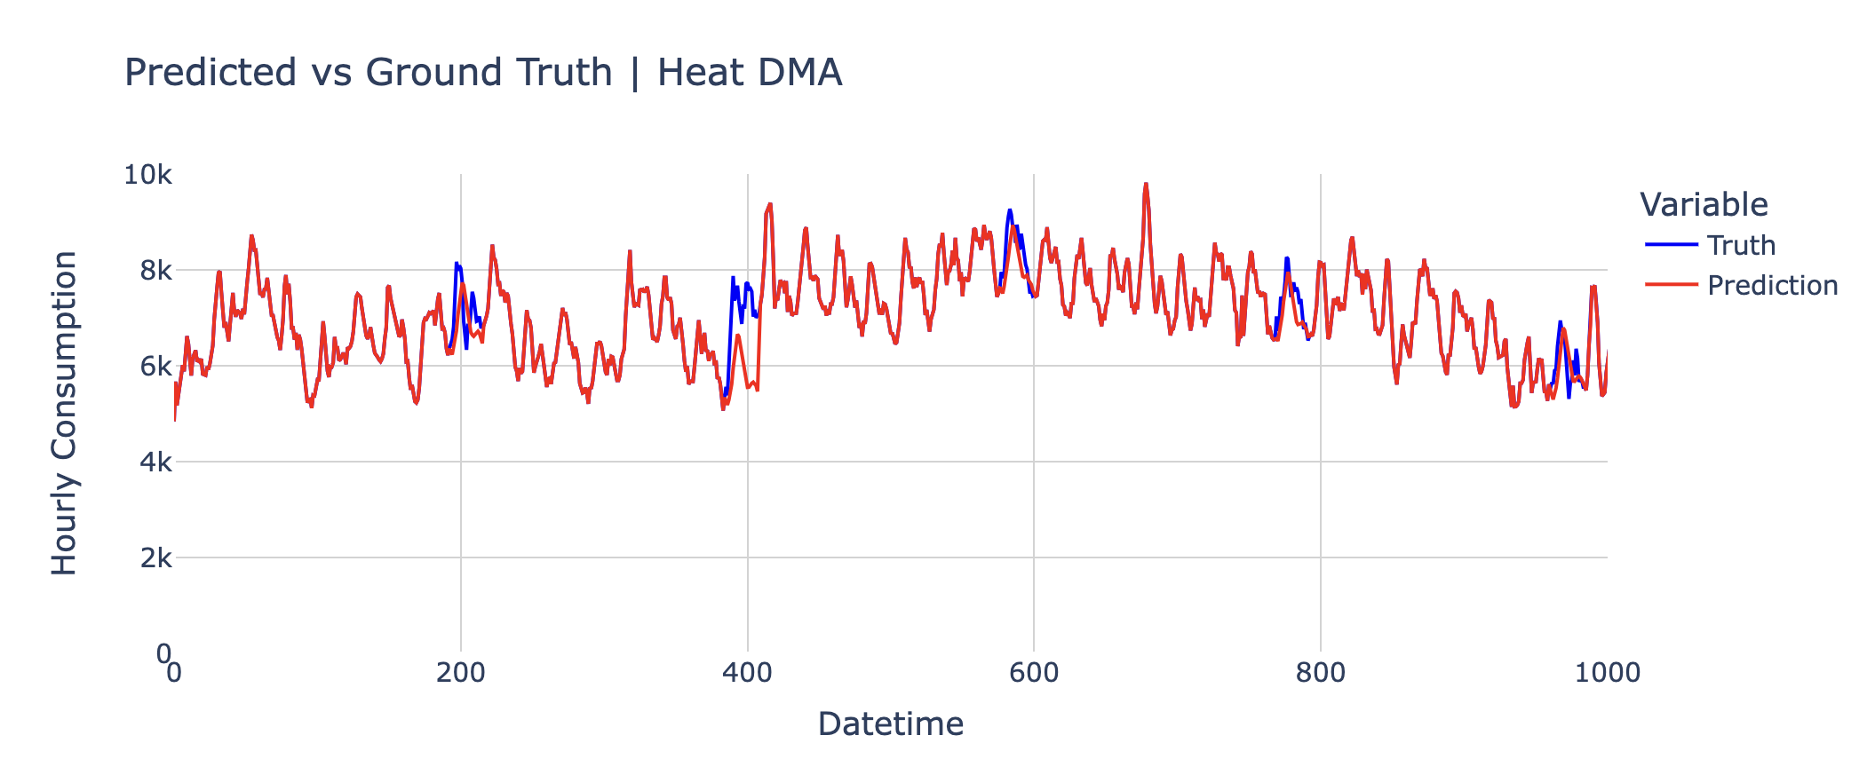

Slide 19
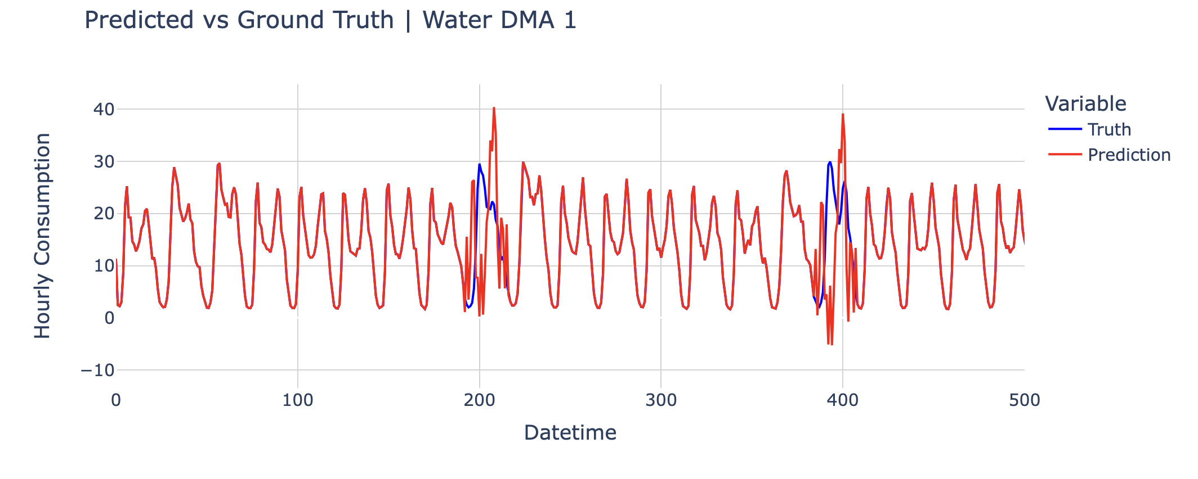

Slide 21
Thank you !

